Slide 1
D-Latches (gated)
D
Q
In a D-latch, the output follows the input when the clock is high.
C
clk
When the clock is low, the output remains what it was on the falling edge of the clock.
D
R
Q
S
En
Q
clk
Clock
D
Q

Slide 2
Edge-triggering
In a positive edge-triggered D Flip-Flop, the output looks at the input only during the instant that the clock changes from low to high.
D
Q
The “carrot”
symbol means
edge-triggered
clk
Clock
D
Q
Edge-triggered D Flip-flop: Every rising edge, output is set to the input

Slide 3
Negative Edge-triggering
In a negative edge-triggered D Flip-Flop, the output looks at the input only on the falling edge of the clock.
D
Q
clk
Clock
D
Q
Negative Edge-triggered D Flip-flop: Every falling edge, output is set to the input

Slide 4
Triggering on an Edge
We want to briefly enable the FlipFlop whenever we find a rising edge
D
Q
clock
en
en
clock
Rising
Edge
Detect
edge
clock
clock
edge
d
d
edge
Edge detection using the time delay through an inverter
In reality, this will be delayed by the AND gate

Slide 5
J-K Flip-Flops
We want to eliminate the forbidden state of the R-S Latch (when R and S are both 1).
Idea: Q, Q’ are always different. Use them to control the input.
R
Q
Q
K
J
S
Q
Q
clk
J_{t} K_{t} Q_{t} Q_{t+1}
0 0 0 0
0 0 1 1
0 1 0 0
0 1 1 0
1 0 0 1
1 0 1 1
1 1 0 1
1 1 1 0
Hold
J, K act just like Set and Reset, except: When they’re both 1, we get a toggle.
Reset
Set
Toggle

Slide 6
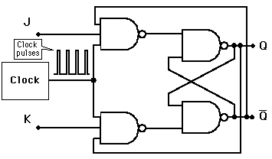

Slide 7
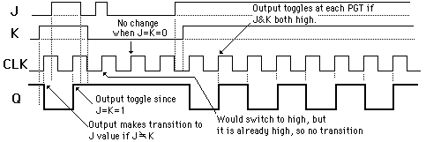

Slide 8
Toggle Flip-Flops
Build a flip-flop that toggles its state on each clock edge when
it is enabled (T is the enable).
Q
Q⁺ is the Q output after the clock changes
T
Q
J
Q
Q
T Q Q⁺
0 0 0
0 1 1
1 0 1
1 1 0
T
K
Q
Q
T
D
Q
Q
clk
clk
Clock
T
Q

Slide 9
Racing the clock
D
D
Q
Q
Real signals don’t change instantly
Clk
Clk
D
D is changing during the rising edge of Clk. Is a ‘1’ or ‘0’ clocked in?
D is changing right after the rising edge of Clk. Is a ‘1’ or ‘0’ clocked in?

Slide 10
Setup and Hold Times
Setup Time: How long a signal must be stable preceding the clock edge
D
D
Q
Q
Clk
Hold Time: How long a signal must be stable after the clock edge
setup
time
hold
time
Clk
D
Setup: Pass
Hold: Pass
Setup: Fail
Hold: Pass
Setup: Pass
Hold: Fail
Setup: Fail
Hold: Fail

Slide 11
Setup and Hold times: Flip Flops
20ns
5ns
20ns
5ns
74LS74 Positive
Edge Triggered
D Flipflop
Clk
D
Q
23/13ns
40/25ns
• Setup time – 20ns
• Hold time – 5ns
• Propagation delays
- Low to High – 23 ns max, 13 ns typ
- High to Low – 40 ns max, 25 ns typ

Slide 12
STATE DIAGRAM REPRESENTATION OF FLIP FLOP

Slide 13
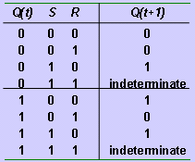
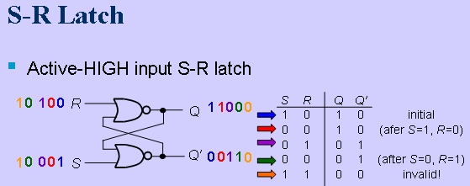


Slide 14
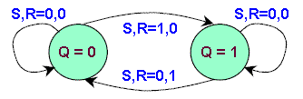
SR FLIP FLOP

Slide 15
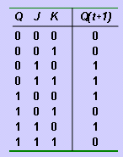

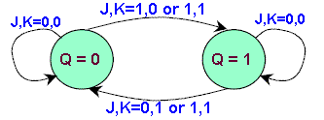
JK FLIP FLOP

Slide 16
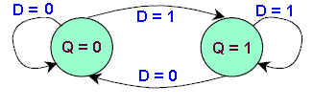
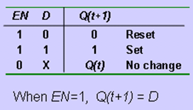
D FLIP FLOP

Slide 17
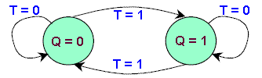
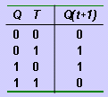

T FLIP FLOP

Slide 18
Asynchronous flip-flop inputs

Slide 19
The normal data inputs to a flip flop (D, S and R, or J and K) are referred to as synchronous inputs because they have effect on the outputs (Q and not-Q) only in step, or in sync, with the clock signal transitions.
There are extra inputs that can set or reset the flip-flop regardless of the status of the clock signal are called as asynchronous because they. Typically, they're called preset and clear

Slide 20
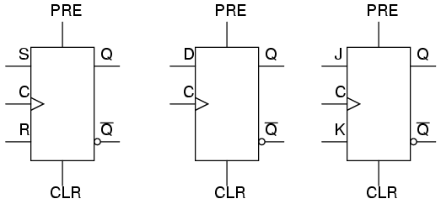

Slide 21
When the preset input is activated, the flip-flop will be set (Q=1, not-Q=0) regardless of any of the synchronous inputs or the clock.
When the clear input is activated, the flip-flop will be reset (Q=0, not-Q=1), regardless of any of the synchronous inputs or the clock. So, what happens if both preset and clear inputs are activated?
We get an invalid state on the output, where Q and not-Q go to the same state, Preset and clear inputs find use when multiple flip-flops are ganged together to perform a function on a multi-bit binary word, and a single line is needed to set or reset them all at once.

Slide 22

Asynchronous inputs, just like synchronous inputs, can be engineered to be active-high or active-low. If they're active-low, there will be an inverting bubble at that input lead on the block symbol, just like the negative edge-trigger clock inputs.

Slide 23
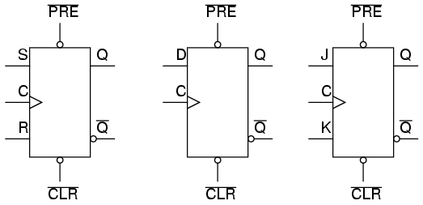
Sometimes the designations "PRE" and "CLR" will be shown with inversion bars above them, to further denote the negative logic of these inputs:

Slide 24
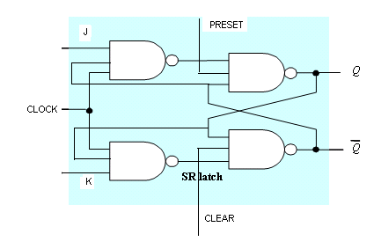

Slide 25
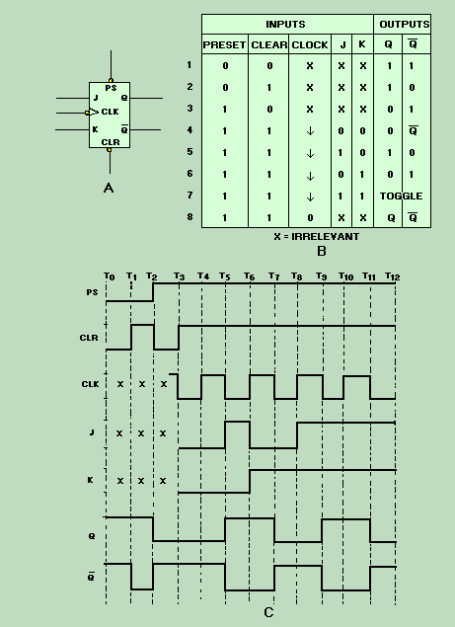

Slide 26
REVIEW:
Asynchronous inputs in a flip-flop have control over the outputs (Q and not-Q) regardless of clock input status.
These inputs are called the preset (PRE) and clear (CLR). The preset input drives the flip-flop to a set state while the clear input drives it to a reset state.
It is possible to drive the outputs of a J-K flip-flop to an invalid condition using the asynchronous inputs, because all feedback within the multivibrator circuit is overridden.

